Slide 1



Anthony Giusti Brad Daniels David Grace Elena Castaneda

Slide 2

Project Objective
Can economic indicators reveal the negotiating power for a worker’s salary ?
How do these indicators affect the national and regional salaries?
Roles:
David Grace – Data Gathering (API) Labor Statistics
Anthony Giusti – Visualization
Brad Daniels– Data Gathering, cleansing and visualization
Elena Castaneda– Data Gathering, presentation

Slide 3




Data Sources and Retrieval Methods
Retrieve data via CSV
Mortgage Origination Data
API Data Retrieval
National and Regional Unemployment and Wage Data
Retrieve data via CSV
Historical Oil Pricing
Cushing, OK WTI Spot Price FOB
Retrieve data via CSV
Consumers Price Index (CPI), US Employment Data and US Average Income Rates

Slide 4
Data Exploration and Cleanup Process
Bureau of Labor Statistics- API
Available data series
CEU0800000003: National Employment , Hours and Earnings
EES10140001: National Employment , Hours and Earnings (SIC basis)
LAUCN28107000000003: Local Area Unemployment Statistics
API Key vs no API Key
system-allowed limit of 25 /50 series
daily limits on data pulls
Consolidating multiple series

Slide 5
Data Exploration and Cleanup Process
Retrieve data via CSV
FRED, the Federal Reserve Economic Data website. (https://fred.stlouisfed.org)
Interest Rates,
Oil Prices,
Consumer Price Index (Inflation)
US Employment
Average Hourly Earnings.
Mortgage Bankers Association
Mortgage Data

Slide 6
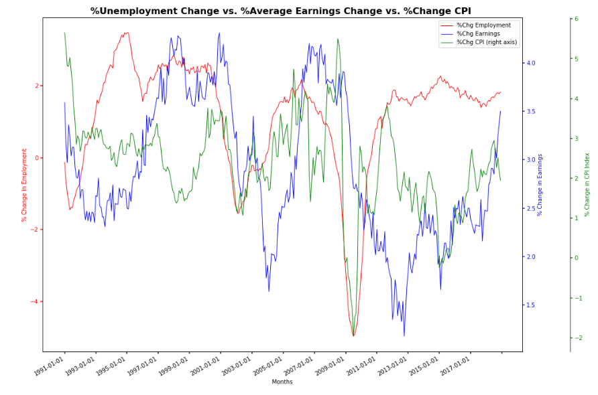
National Indexes
Percentage Change of Unemployment Rate, Average Earning and CPI Index

Slide 7
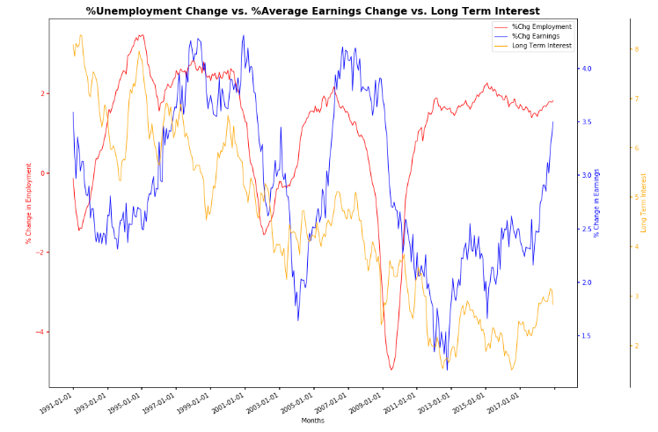
National Indexes
Percentage Change of Unemployment Rate, Average Earning and Long Term Interest Rate

Slide 8
Regional Analysis
Oil industry in the Texas oil towns of Houston, Midland, Beaumont

Slide 9
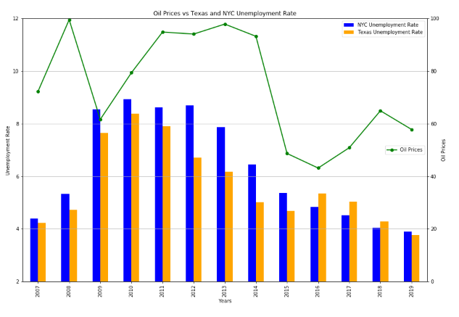
Texas Oil Towns

Slide 10
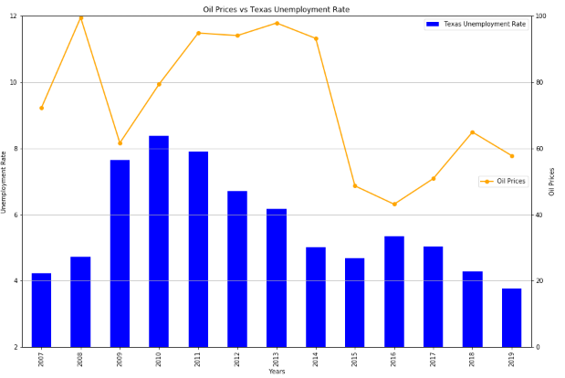
Texas Oil Towns

Slide 11
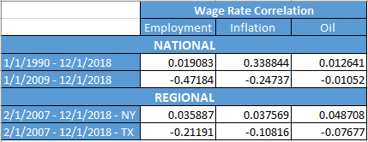
Wage Rate Correlation

Slide 12

In Closing…

